Slide 1



ProductDashboard_Challenge_Finish

Slide 2
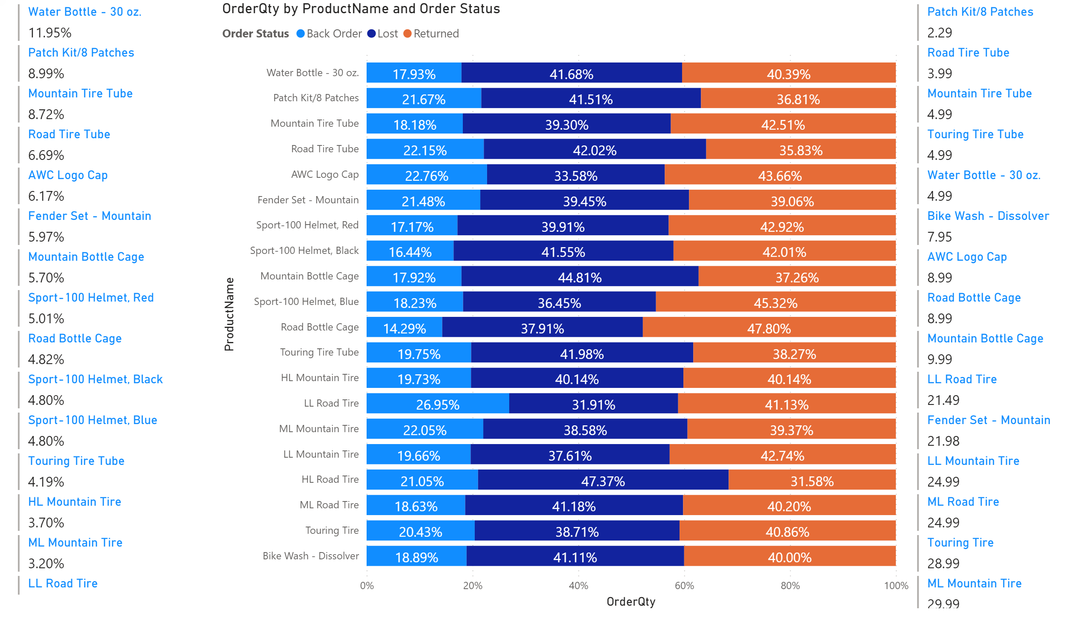
FirstDraftProducts
Notes:
multiRowCard
No alt text provided.
hundredPercentStackedBarChart
No alt text provided.
multiRowCard
No alt text provided.

